Slide 1
Areeb ur Rahman khan

Slide 2
Introduction
Name: Areeb Ur Rahman Khan
Age:19
Gender: Male
Height: 5’8
Date of Birth: 3rd September

Slide 3
Family
My mother is a doctor.
My father is employed in a multinational company.
I have 3 sisters, two are older than me and one is younger.

Slide 4

Residence
Gulshan, Karachi
I live in a double story house
I live on the first floor, my cousins live on the ground floor.
There are 3 bedrooms, a drawing room, a lounge and a kitchen in my house.

Slide 5
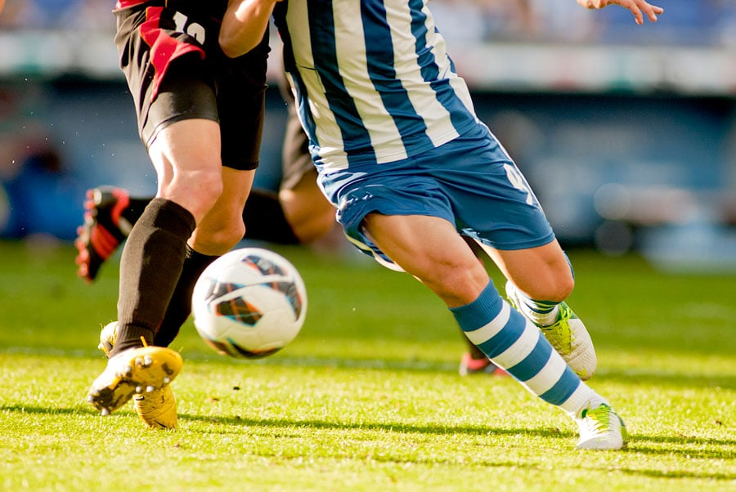
childhood
Born in Karachi, Pakistan.
I was a very naughty child who used to run around all day, playing games.
I used to play computer games as well as physical games such as football, cricket etc.

Slide 6
education
I have completed my primary education from Montessori Complex School.
For O levels, I went to Fahim’s Public School.
I completed my A levels from Lyceum College
Currently, I am enrolled in IBA for the BBA program.

Slide 7

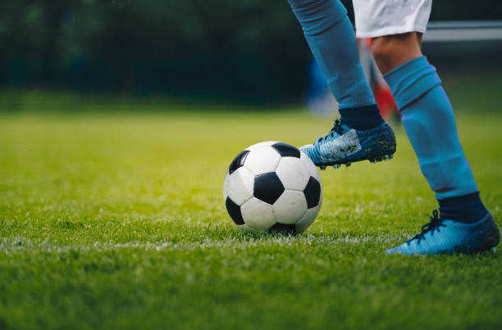
interests
My one major interest in life is football.
I have played football for over 7 years now and I play exceptionally well.
I was the captain of my team in my school years and we won plenty of matches and tournaments.
I was also in the football team in my college and we participated in many tournaments where I displayed my skills and won trophies alongside my teammates.

Slide 8
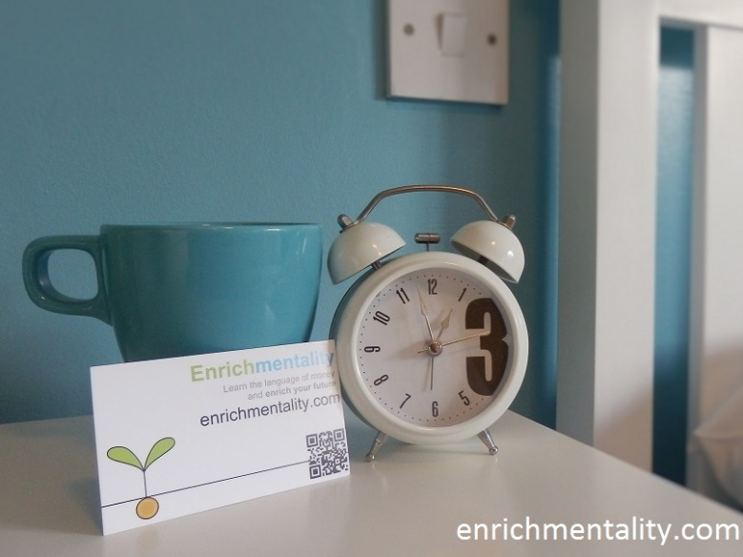
Hobbies
Sports
Community Service
Travelling and exploring
Video Games

Slide 9
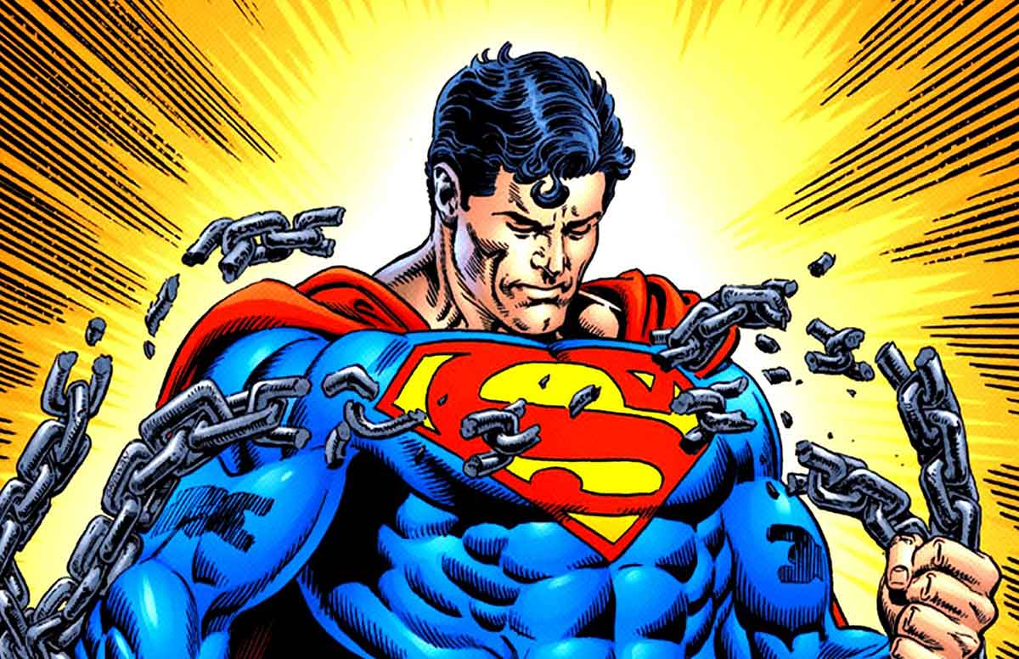
Strengths
Creativity
Communication Skills
Patience
Control over anger
Team player
Optimism
Versatility

Slide 10

Weaknesses
Self-criticism
Insecure
Too detail oriented
Advocating on behalf of myself
Trouble saying ‘No’
Unhealthy life balance
Procrastination

Slide 11
THE END

